Slide 1

Linq and Lambda
Lecturer
Rokas Slaboševičius
Data

Slide 2
Today you will learn
LINQ and Lambda
What is lambda?
01
What is LINQ?
02
Different uses of LINQ
03

Slide 3
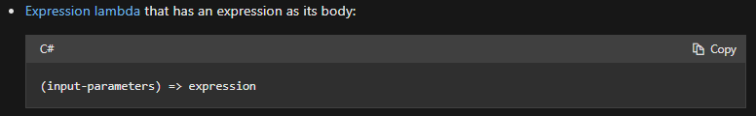
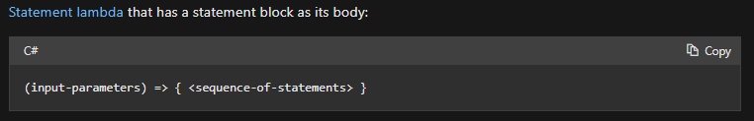
Lambda =>
LINQ and Lambda
Lambda expression is used to create anonymous methods.
Lambda syntax has two forms:

Slide 4
Lambda =>
LINQ and Lambda
To create a lambda expression, we describe the input parameters on the left and the lambda operator(=>) on the right, which is what we want to do.

Slide 5


Lambda =>
LINQ and Lambda
Func<int, int> Encapsulates a method that has one parameter and returns a value of the type specified by the TResult parameter.

Slide 6
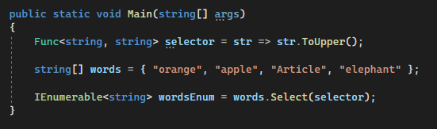
Lambda =>
LINQ and Lambda
First, we create a delegate Func with input type string and output type string, and assign an anonymous function "str => str.ToUpper();" to its value
Then, after creating the array words, you can iterate over it with the Select method and pass the selector delegate

Slide 7
Lambda =>
LINQ and Lambda
The same can be achieved without creating a separate variable for the delegate and by creating an anonymous function in the parameters of the Select method.

Slide 8
LINQ
LINQ and Lambda
Basic LINQ methods:
Select() - used when you want to select ALL items from a list according to a condition.
Where() - used to retrieve only the elements that satisfy the condition, e.g.: x => x < 10.
OrderBy() - used to specify that you want to sort the list in ascending order, it is also possible to specify by which object parameter you want to sort'int, e.g.: person => person.Name.
SingleOrDefault() - used to get a single or default'ini item from a list based on a condition.
Single() - to get a single item from a list according to a condition.

Slide 9

LINQ and Lambda
Task 1
Create a list with numbers. Create a new list and assign to its value the list returned by the first Select list. The Select method must square each number in the first list.
Create a list of positive and negative elements, create a new list from it with LINQ returning only positive numbers.
Create a list of positive and negative elements, create a new list from it with LINQ, returning only positive numbers not greater than 10.
Create a list of numbers and use LINQ to sort them in ascending order.
Create a list of numbers and use LINQ to sort them in descending order.
Find the largest item in the list of numbers using LINQ.
Create a Person class with Name and Age parameters, create a list of these objects.
Create a new list with LINQ taking only people's names, the other list from age only.
Sort the list in descending order of age.
Create a new list of people whose names start with the letter A.
Create a new list of people aged 40+ and sort it by name.

Slide 10
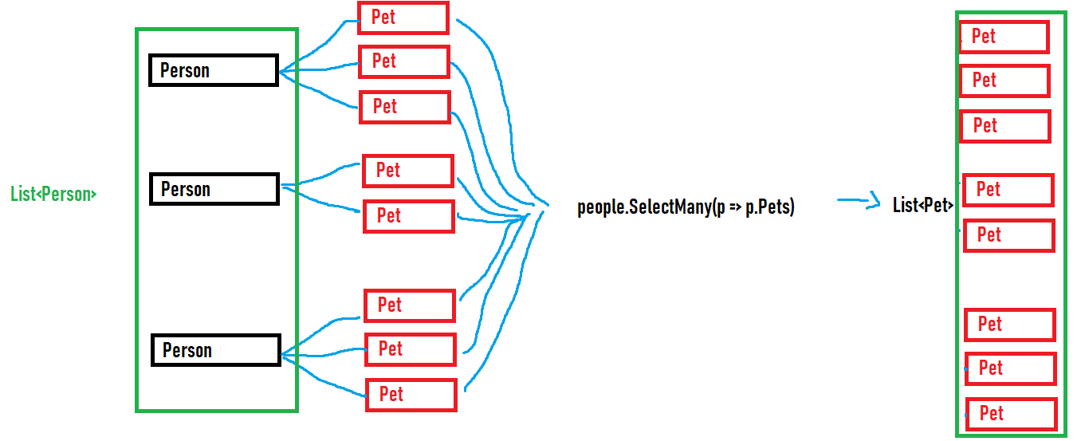
LINQ
Lambda
SelectMany() - If we have a class Person and it has a list of Pets inside, then if we write people.SelectMany(p => p.Pets) we will get the list of ALL animals in the Person class

Slide 11
LINQ and Lambda
Task 2
Create a Person class with a name and a list of animals (also a new class, the animals have only a name). Create a list with Person objects and lists of animals inside.
With LINQ Select and SelectMany, create a list consisting of all the animals in the list.
Another list will consist only of animals whose names start with the letter A.
Add the age int Age to the Pet class, make another list of animals with names starting with the letter A and aged over 5 years.
Write a method that accepts one string parameter. Write a LINQ function to return words that are all uppercase.

Slide 12
LINQ and Lambda
Task 3
Find online functionality to get a list of files from a specified directory.
Write LINQ functionality to get all file extensions (e.g. .txt, .csproj)
Write LINQ functionality to retrieve all text files(.txt)
Write LINQ functionality to get the names of all text files in the directory (only the filename must be present e.g. 'text.txt')

Slide 13
LINQ and Lambda
LINQ method syntax
https://www.geeksforgeeks.org/linq-method-syntax/
https://www.tutorialsteacher.com/linq/linq-method-syntax
Useful information

